Slide 1
Post Graduate Certificate Programme in Data Science For Business Excellence And Innovation (DBI002)
Place: IIM Nagpur
Year: 2022-23
Capstone Project Presented by
Group 06
Sr. | Name of Group Members | Email ID
1 | Bhagyashree Vyas | dbi002_bhagyashree@iimnagpur.ac.in
2 | Chacko John Kuntharayil | dbi002_chacko@iimnagpur.ac.in
3 | Rohan Wanzkhade | dbi002_rohan@iimnagpur.ac.in
4 | Sagar Sambashiv Falke | dbi002_sagar@iimnagpur.ac.in
5 | Saurabh Sheetlaprasad Dubey | dbi002_dubey@iimnagpur.ac.in

Slide 2
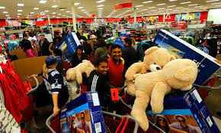
Black Friday Sales
What is Black Friday Sale?
Black Friday is the term for the Friday after the Thanksgiving in US.It is tradionally marks the start of the Christmas shopping season in the US.Many stores offer highly promoted sales at a discounted priceand often open early or sometimes as early as midnight or even on Thankgiving.
Approach:
Python Programming: Where We will Be Importing Libraries like Pandas
And for EDA Matplotlib And Seaborn.
Data Visualization tool : Power Bi
Notes:
aWhat Is Black Friday Sale?
Black Friday Is a Term for the Friday after Thanksgiving in the US.It is Traditionally marks the start of the Christmas shopping season in the US.Many stores offer Highly promoted sales at discounted price and often open early,sometimes as early as midnight or even on Thanksgivings

Slide 3
Project Aim: Analysing the Black Friday sales to understand the customer behaviour based on their demographics and product details.
Project objectives:
1. Create a Buyers Demographics dashboard with charts showing the count of customers in different categories in each demographic’s variable.
2. Create a Spending Dashboard to showcase the amount of money spent by different demography of buyers. This can include charts such as marital status and age groups vs total spending, occupation and gender vs total spending, etc.
3. On a Conclusion dashboard mentioning observation and findings from the analysis.
Problem Statement:
The problem to be addressed is to analyse and interpret Black Friday sales data to gain insights into customer behaviour and preferences. This includes identifying the most popular products, the purchasing patterns of different customer segments. Additionally, the analysis could focus on identifying any opportunities to increase sales or improve customer satisfaction during future Black Friday sales events.

Slide 4
The dataset consists of 537577 rows (transactions) and 12 columns (features) described below:
User_ID: This column represents the unique ID of each user. There are a total of 5891 users in the dataset.
Product_ID: This column represents the unique ID of each product. There are a total of 3623 products in the dataset.
Gender: This column indicates the gender of the person making the transaction.
Age: This column indicates the age group of the person making the transaction.
Occupation: This column shows the occupation of the user, already labelled with numbers 0 to 20.
City_Category: This column represents the user's living city category. The cities are categorized into three different categories: 'A', 'B', and 'C'.
Stay_In_Current_City_Years: This column indicates how long the user has lived in the current city.
Marital_Status: This column is 0 if the user is not married and 1 otherwise.
Product_Category_1 to Product_Category_3: These columns represent the categories of the product. All three categories are already labelled with numbers.
Purchase: This column represents the purchase amount.

Slide 5
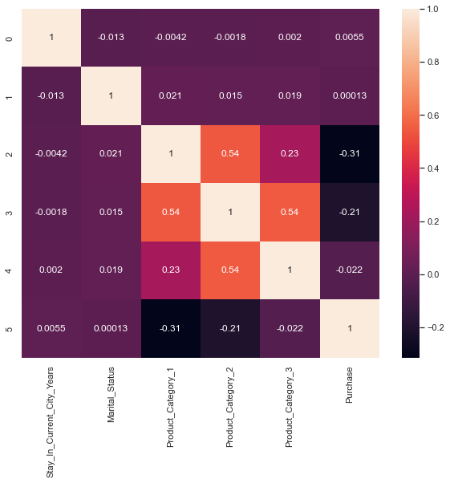
Python Programming
# Import libraries
import pandas as pd
import seaborn as sns
import matplotlib.pyplot as plt
# Create a dataframe from the correlation data
data = {"Stay_In_Current_City_Years": [1, -0.012663171, -0.00418196, -0.001780721, 0.002039186, 0.005469625],
"Marital_Status": [-0.012663171, 1, 0.020545866, 0.015116324, 0.019452474, 0.000129018],
"Product_Category_1": [-0.00418196, 0.020545866, 1, 0.5404235, 0.229490207, -0.314124735],
"Product_Category_2": [-0.001780721, 0.015116324, 0.5404235, 1, 0.543543888, -0.209972881],
"Product_Category_3": [0.002039186, 0.019452474, 0.229490207, 0.543543888, 1, -0.022256581],
"Purchase": [0.005469625, 0.000129018, -0.314124735, -0.209972881, -0.022256581, 1]}
df = pd.DataFrame(data=data)
# Create a heat map using seaborn
sns.set_theme()
plt.figure(figsize=(10,8))
sns.heatmap(df, annot=True)
plt.show()
Notes:
Python Programming

Slide 6
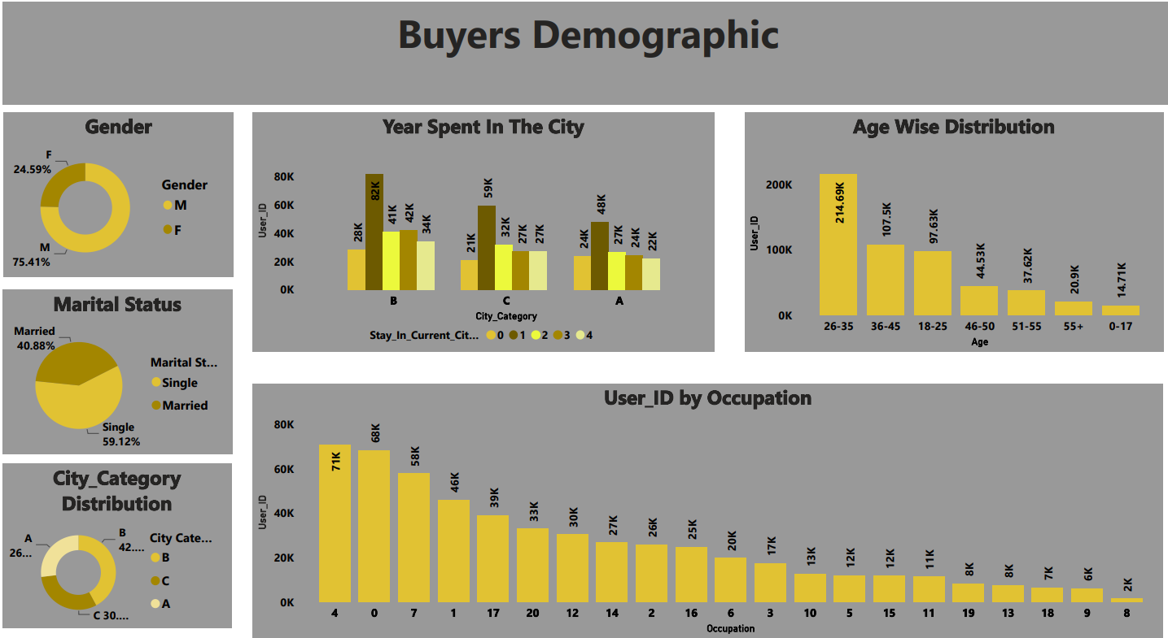

Slide 7
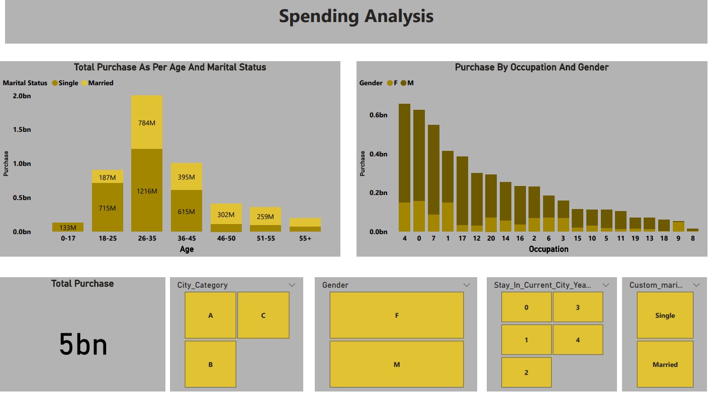

Slide 8
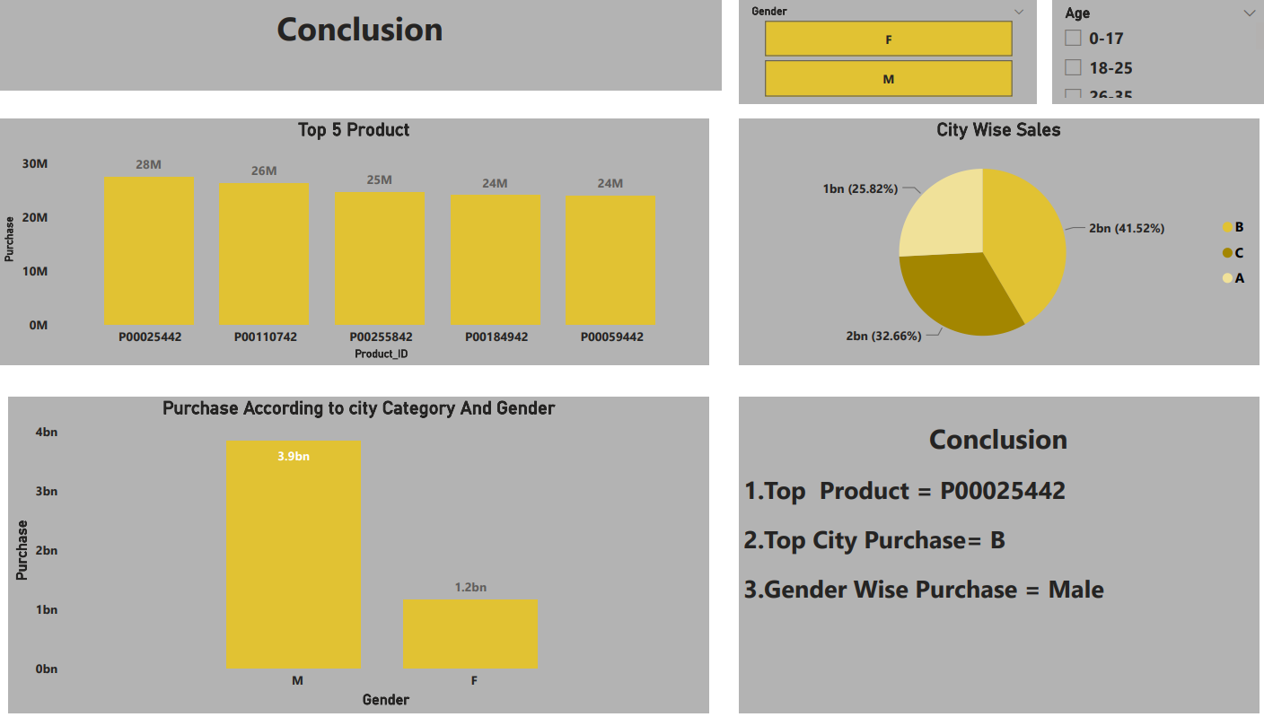

Slide 9

Thank You
Notes:
Thank You

